Slide 1
Predictive biomarker patterns by capillary microscopy
Ulyana Lushchyk*
Viktor Novytskyy
Rostyslav Bubnov
* Veritas group: Igor Babii, Nadija Lushchyk, Ivanna Legka, Lyudmyla Riabets
Veritas R&D Center , Kyiv, Ukraine
Clinic of Healthy Vessels, Kyiv, Ukraine
Brain Vessels Neurorehabilitation, Muscat, Oman
Center for Innovative Medical Technologies “Veritas IT Med”, Kyiv, Ukraine
Feofaniya Clinical Hospital, Kyiv, Ukraine

Slide 2
What is the "unmet need” for PPPM?
Psychological problems, brain exhaustions have a risk to be accumulated and pass to chronic psychosomatic and psychomuscular fixed vascular disorders, which can become a trigger for pathological stress vascular reactions as the Flammer-syndrome.
Today speed of information, decision-making and answer-forming has passed to an instantaneous level, which considerably increases loading on the brain and vascular system.
A problem of early diagnosis and correction of vascular dysfunctions in the brain becomes extremely important both in childhood and to save manpower efficiency.
Every second inhabitant of the planet has minimal malfunction of the brain’s vessels.
Early signs of the vascular diseases are difficult to diagnose.
Late signs of vascular and brain dysfunctions are difficult to treat.

Slide 3
What are the target populations for PPPM intervention?
All population at:
Vascular screening biomarker’s centers;
In-patient and out-patient departments, hospitals, medical centers, hospices, sanatoriums, SPA-centers;
Resuscitation departments and centers of critical condition;
Rehabilitation departments and centers;
Pregnancy and new-born departments;
Pediatric and cardiological departments;
Psychoneurological departments;
Angio- or/and cardiosurgery departments;

Slide 4
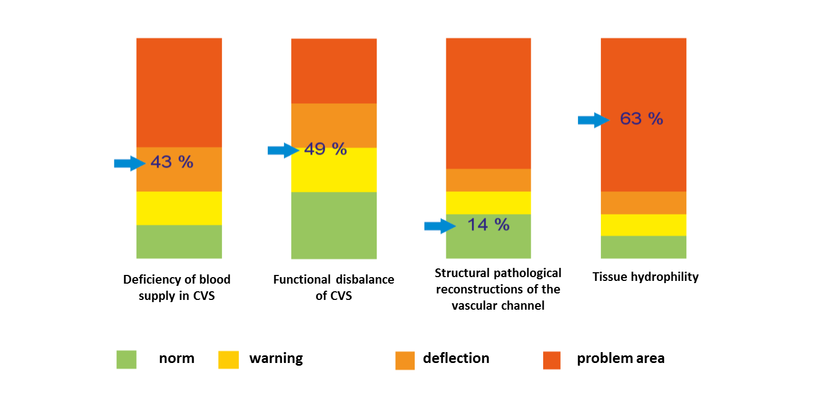
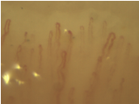
What are the methods used and how accessible are they?
capillary microscopy, which can detect early changes in CVS and thus can prevent serious disorders due to biomarker technology of vascular screening;
A generalized histogram formed on the basis of analysis of several images
4th finger of the left hand

Slide 5
What are the methods used and how accessible are they?
Vascular Biomarker technology for individual evidential angiotherapy
ЗДАМК - Common deficiency of the arterial brain blood supply, АСКБ -Carotid extracranial systolic reservoir, АДКБ - Carotid extracranial diastolic reservoir, АСВБ - Vertebro-basilar extracranial systolic reservoir, ААСе - Extracranial expressiveness of the arterial assymetry, ААСі - Intracranial interhemispheric expressiveness of the arterial assymetry, АЗСРгп - General degree of disbalance — instable hemodynamic parameters (chaos 1,2,3), АЗСРти - General degree of disbalance of pressure, АЗСРел - General degree of disbalance of elasticity , АЗСРто - General degree of disbalance of tonus, АЗСРнп - General degree of disbalance of the head, Анке - Head in CVS — extracranial carotid reservoir, Анкі - Head in CVS — intracranial carotid reservoir, Анссн - Cardiovascular insufficiency, Ансмн - Vascular-cerebral insufficiency, АВБН - Vertebro-basilar insufficiency, АВР - Arteriovenous balance, АВШ - Arteriovenous shunting, АВГР - Arteriovenous hydrodynamic balance, ВЧГРп - intracranial hydrodynamic balance, ВЧГРс - intracranial hydrodynamic balance, ВЧГРз - intracranial hydrodynamic balance, Ввд - Sufficiency of the veous outflow, Ввс - Correctness of the venous structure, Ввто - Venous outflow tonus, Ввт - Venous outflow pressure, ВАГ - Venous angioarchitectonics, Вко - Venous superocular collaterals, Вкхвм - Venous collaterals vertanbal plexus, ВВР - Expressiveness of retrograde throwing, Ввасе - Extracranial eressiveness of the veous assymetry, Ввасі - Intracranial eressiveness of the veous assymetry

Slide 6
What are the methods used and how accessible are they?
All methods are preventive and predictive,
non-invasive and non-traumatic:
1) Technology of vascular screening
2) Technology of angiomarkers
3) Technology of personal evidence based angiotherapy with feed back control
4) Technology of personal evidence based monitoring in angiosurgery

Slide 7
What are the results of our study and how can these be translated into improved PPPM?
The research groups included 378 patients of top-managers and were divided into 4 groups:
1st group (123 persons) - state of pre-illness (astenoneurotic syndrome, neurosis of expectation, post-stress disorder),
2nd group (161 persons) passing into the illness (chronic fatigue syndrome, the Flammer-syndrome, syndrome of professional burning down),
3rd group (57 persons) the illness (vascular dyshemia, oncopathology, dementia),
4th groups (37 persons) critical decompensation conditions (stroke, heart attack, epilepsy, thrombosis, embolism).

Slide 8
What are the results of our study and how can these be translated into improved PPPM?
All patients got medicinal treatment, psychotherapy and psycho correction and rehabilitation sessions for influence on the sensory and motion systems in the brain.
Standard therapy

Slide 9
What are the results of our study and how can these be translated into improved PPPM?
We established correlation dependence between therapeutic influences of medicines on vascular disorders and progresses of psychosomatic disorders in vascular dyshemia in 83% of patients without adequate treatment.
Background personalized
angiotherapy

Slide 10
What are the results of our study and how can these be translated into improved PPPM?
Angiotherapy with
personalized
monitoring in dynamics

Slide 11
What are the results of our study and how can these be translated into improved PPPM?
The clinical signs of the Flammer-syndrome gradually grew up in this group of patients as a display of somatization of vascular dyshemia on organ and metabolic levels.

Slide 12
What are the results of our study and how can these be translated into improved PPPM?
Application of sporting kinesitherapy practices for 46% of patients allowed improving the functioning of the vascular, neurodynamic and neuromuscular systems by activation of auto regulatory mechanisms of the organism’s self-control on the phase of development of the Flammer-syndrome.

Slide 13
What are the benefits for patients and healthcare?
Vascular biomarkers are the real decision for the early prevention of CVS’s disorders.
Biomarkers of vascular disorders are an innovative technology, which is able to find early functional and structural problems in vascular system of the whole human body.

Slide 14
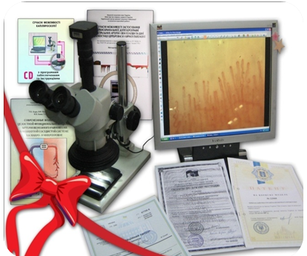
What are the benefits for patients and healthcare?
According to the results of the conducted researches it is expedient to change the treatment algorithms for psychoneurological patients with the purpose of more rational use of costs and reaching greater effect, bringing the nervous system on the auto regulation level and self-control of neuronets, renewal of self-service and capacity.

